Slide 1
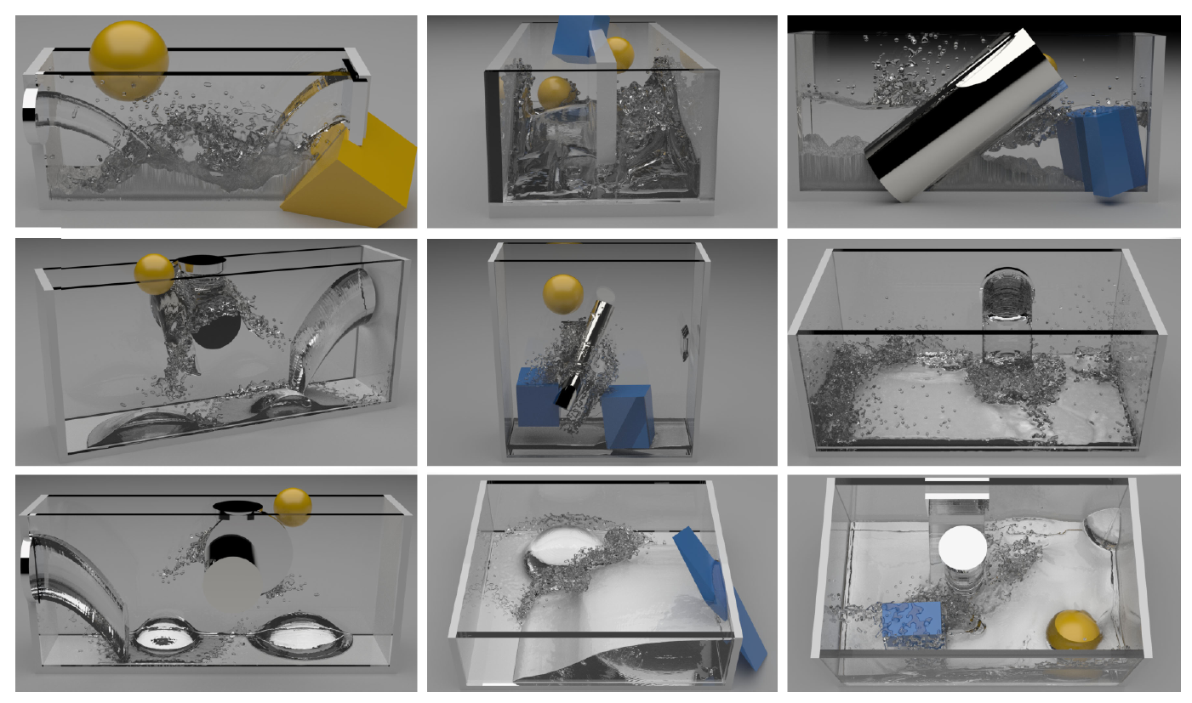
Data-driven Fluid Simulation
张雅斓
06.05

Slide 2
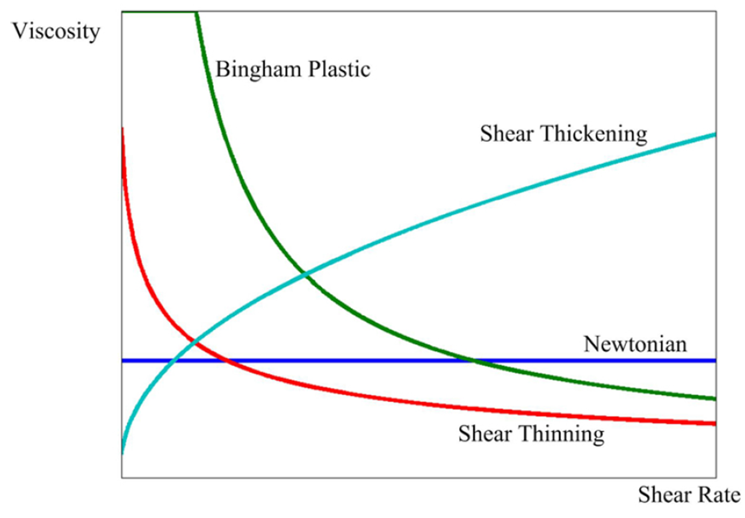
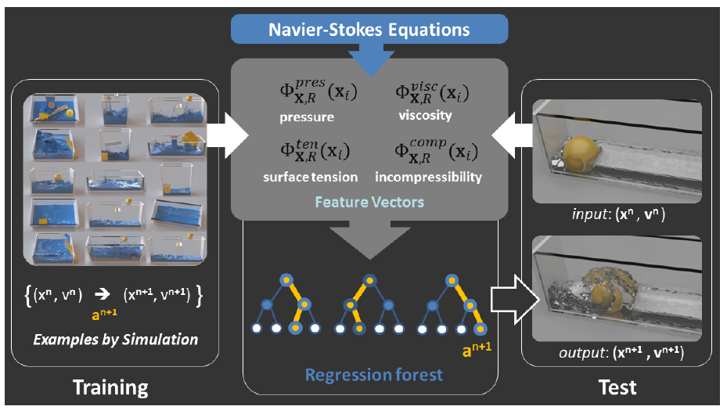
The Plan
The SPH Fluid Simulation
Feature Vector
Machine Learning

Slide 3
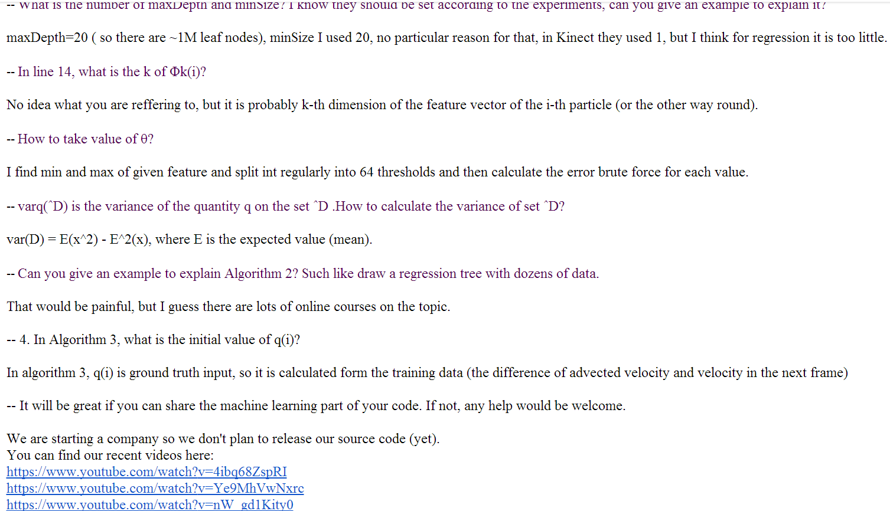
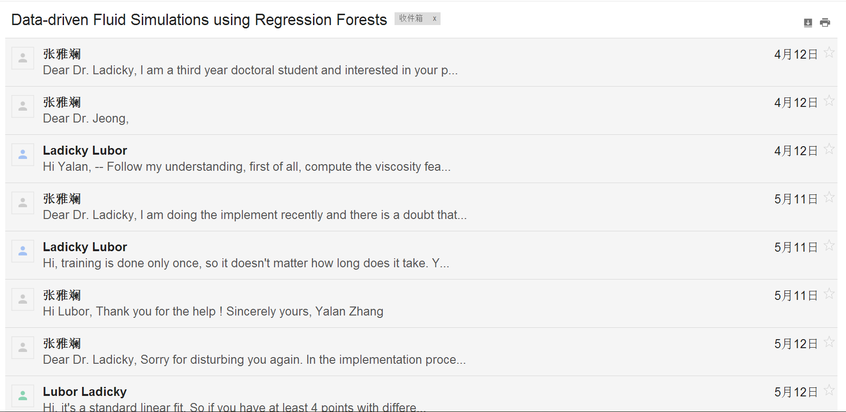
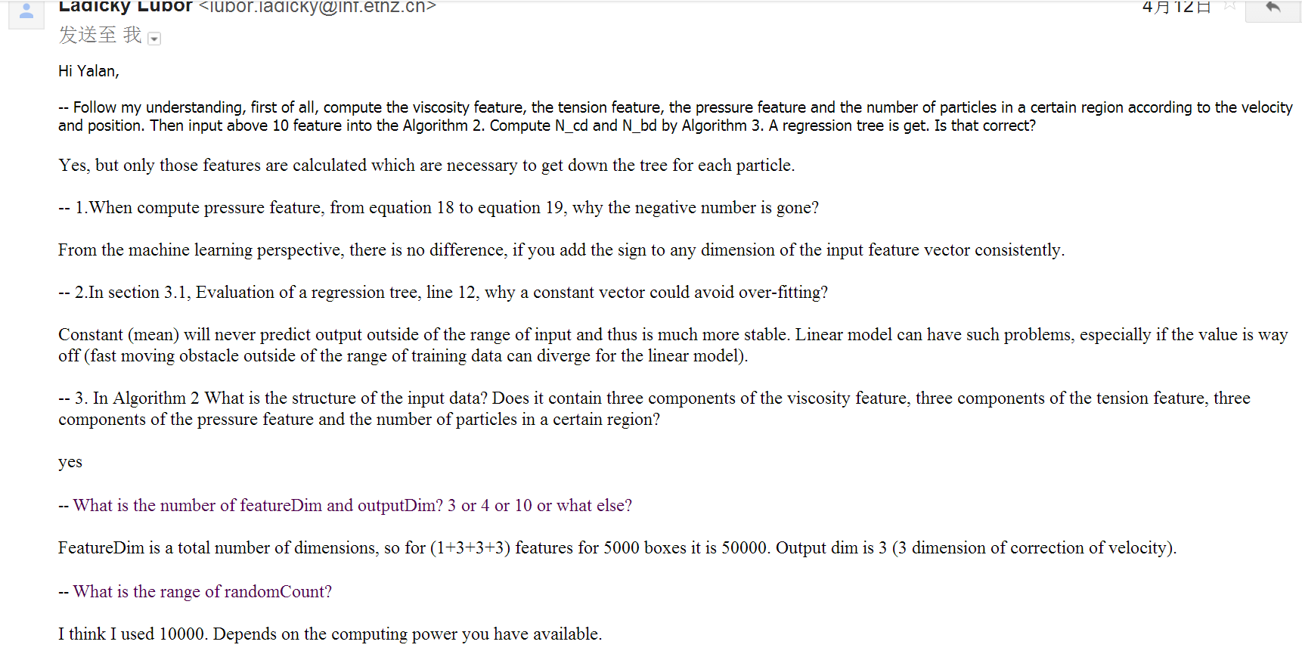
Data-driven Fluid Simulation

Slide 4
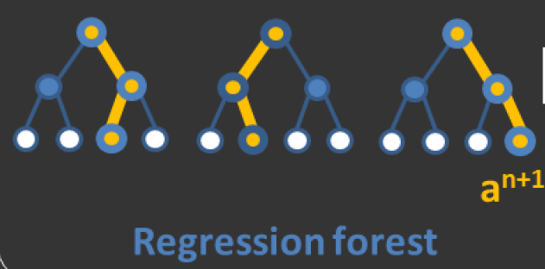
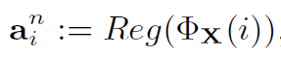
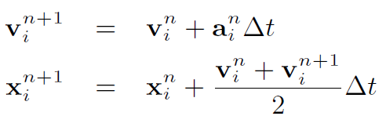
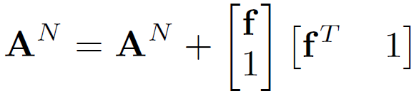
Data-driven Fluid Simulation

Slide 5
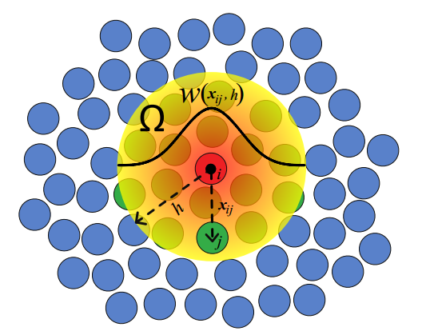
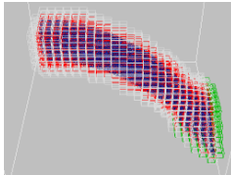
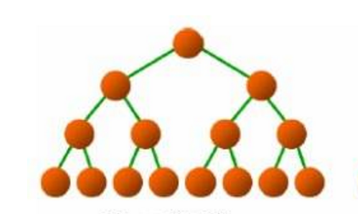
Data-driven Fluid Simulation

Slide 6
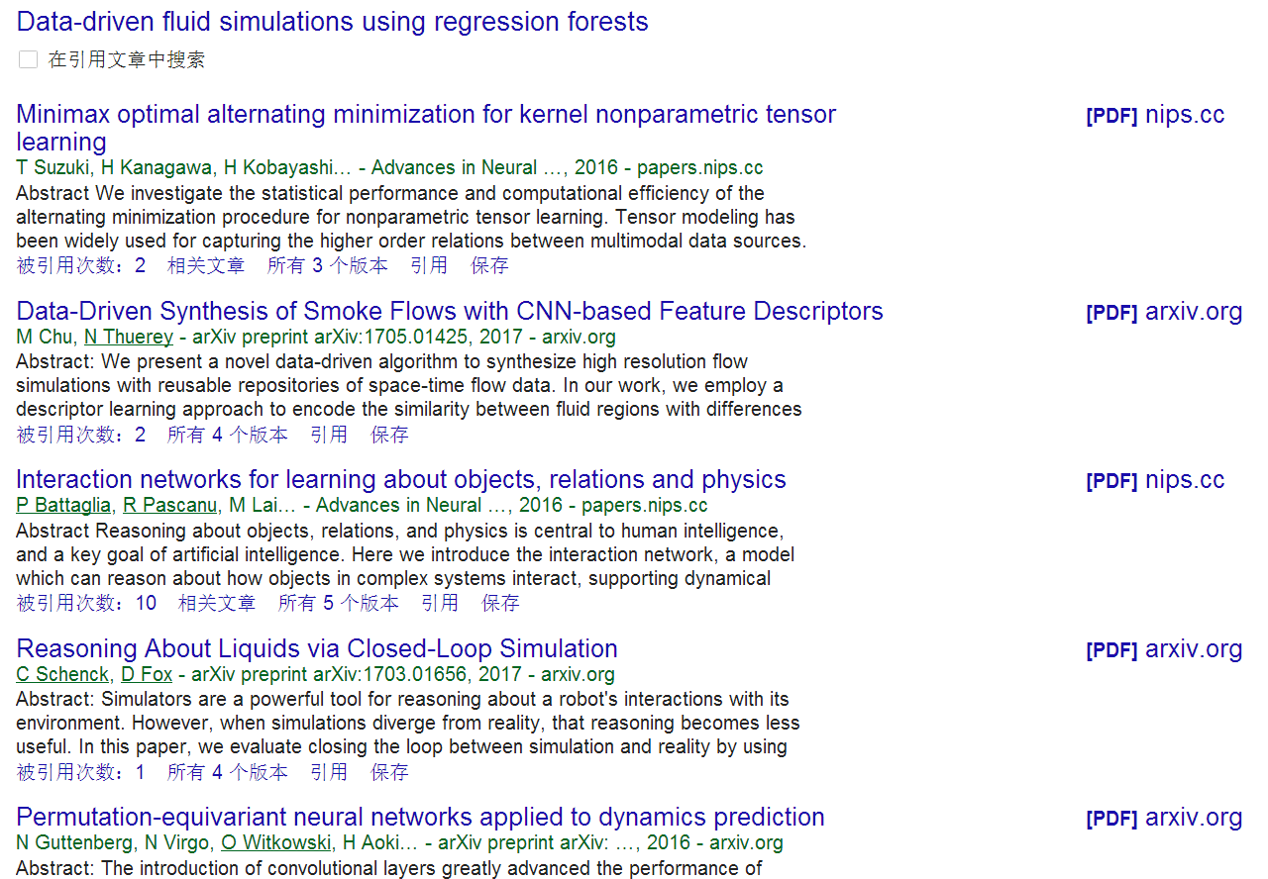
Data-driven Fluid Simulation

Slide 7
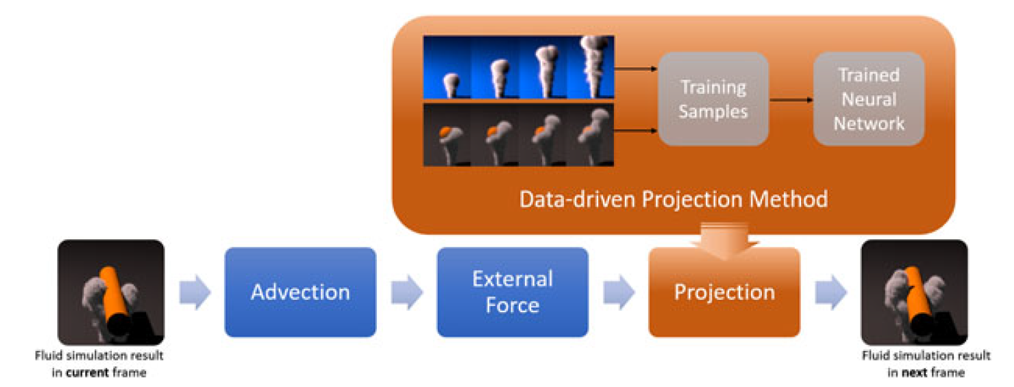
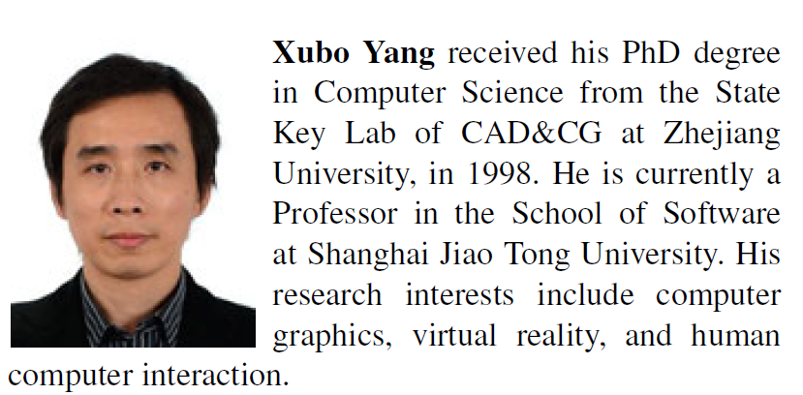
Data-driven projection method in fluid simulation
Yang C, Yang X, Xiao X. Data‐driven projection method in fluid simulation[J]. Computer Animation and Virtual Worlds, 2016, 27(3-4): 415-424.

Slide 8
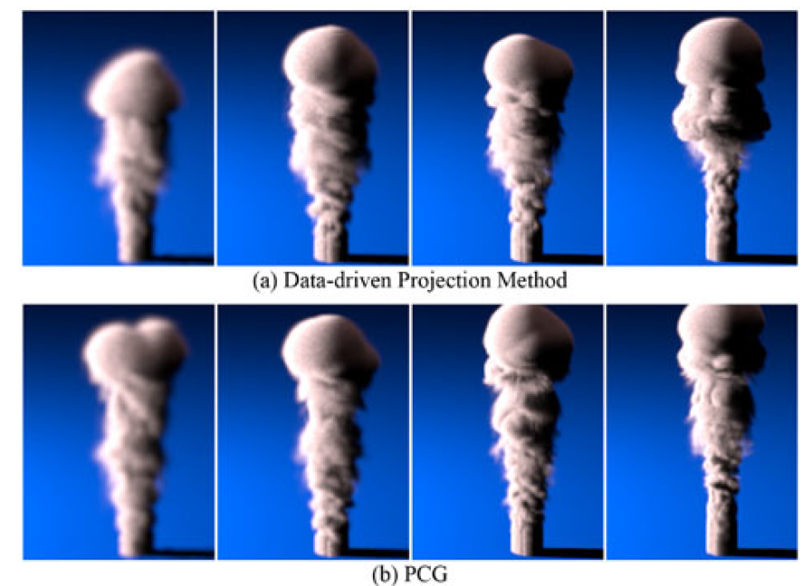
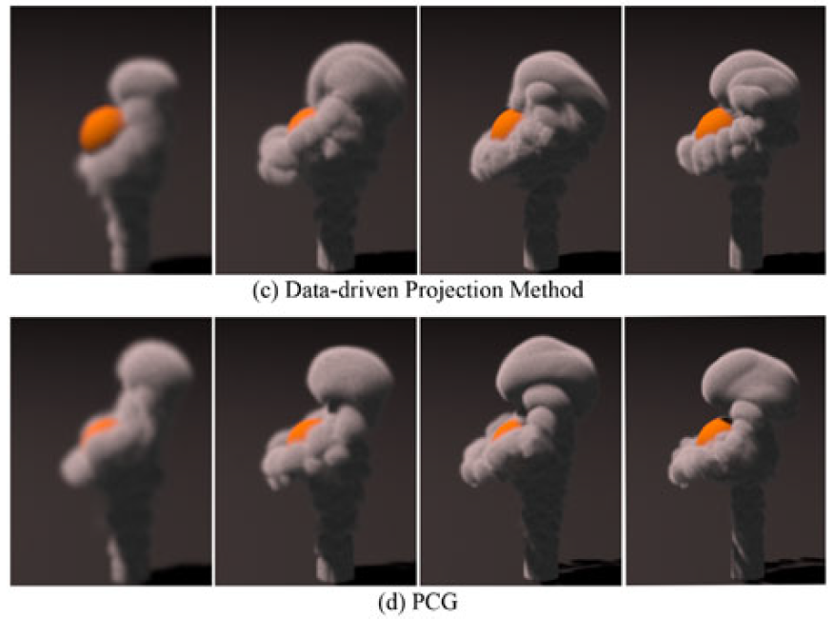
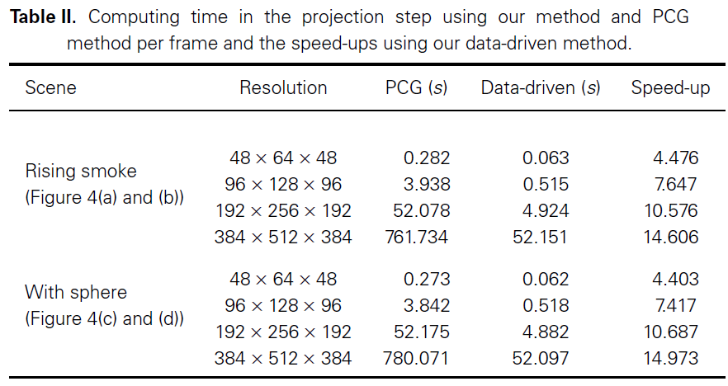
Data-driven projection method in fluid simulation
Yang C, Yang X, Xiao X. Data‐driven projection method in fluid simulation[J]. Computer Animation and Virtual Worlds, 2016, 27(3-4): 415-424.

Slide 9
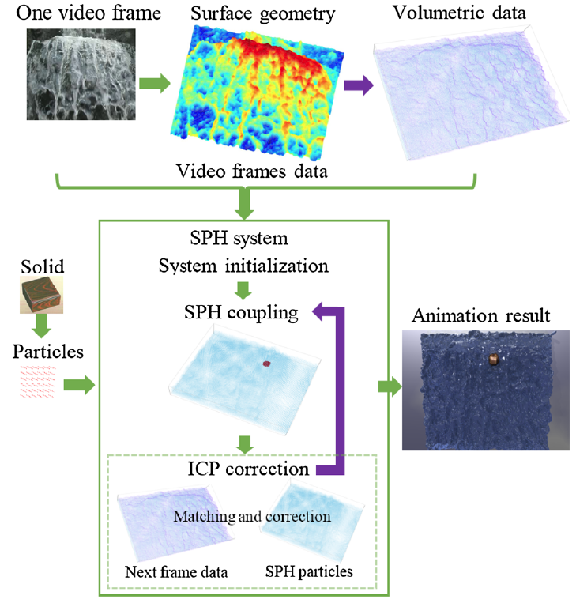
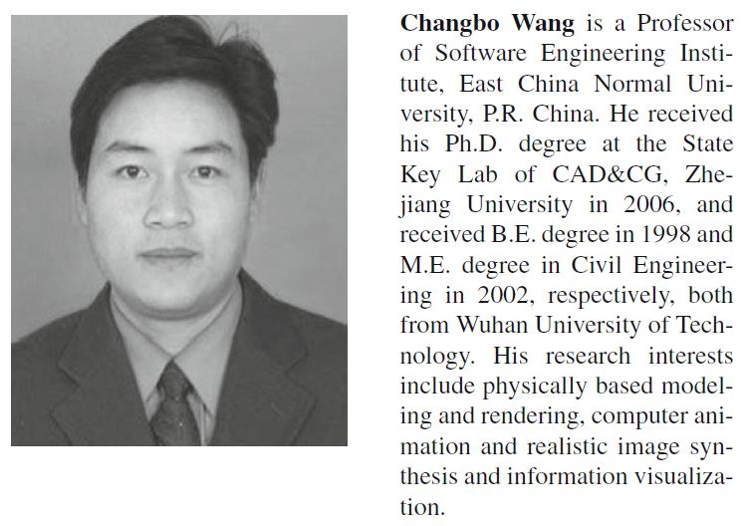
Video-based fluid reconstruction and its coupling with SPH simulation
Wang C, Wang C, Qin H, et al. Video-based fluid reconstruction and its coupling with SPH simulation[J]. The Visual Computer, 2016: 1-14.

Slide 10
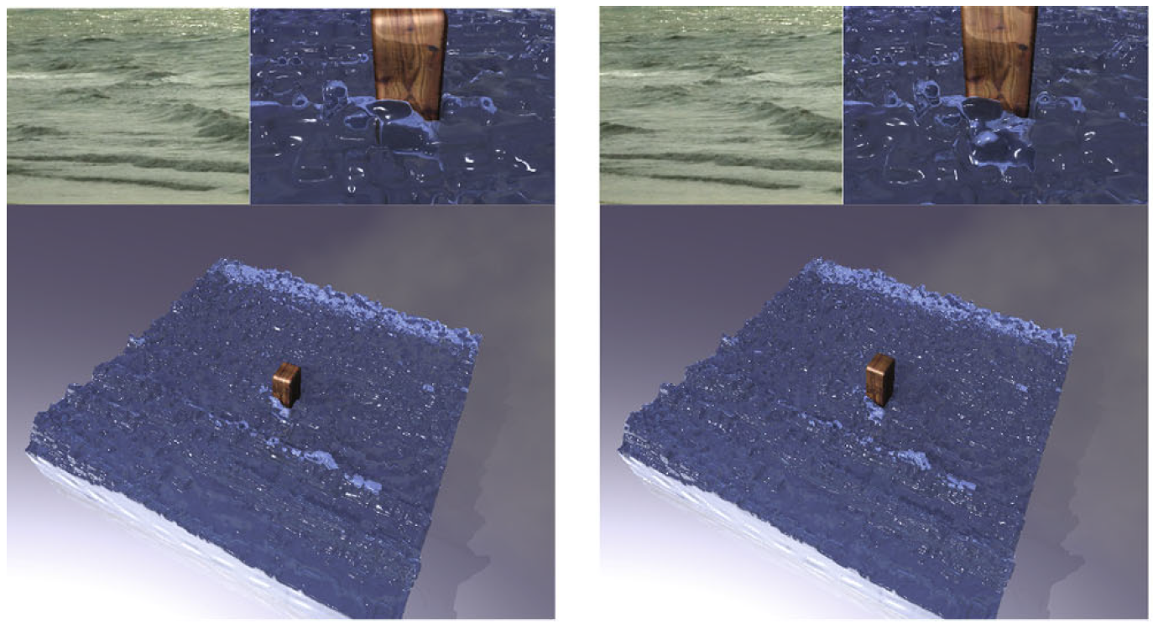

Slide 11
Future Work
The SPH Fluid Simulation
Feature Vector
Machine Learning

